Slide 1
TAS152
LECTURE 11
TOPIC 2
ETHICS IN THE INFORMATION SOCIETY
2.4 PROFESSION: ETHICS OF INFORMATION PROFESSIONALS

Slide 2
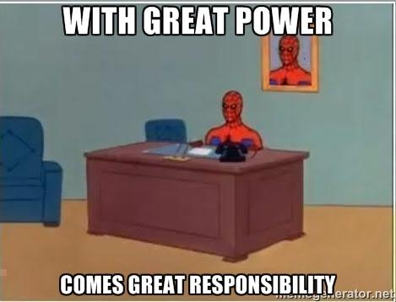
TOPIC 2 – ETHICS IN THE INFORMATION SOCIETY
Information professionals must assume responsibility for building a culture of honesty, transparency, independence and integrity.
Adhere to professional codes of ethics
Don't prioritise profit above ethical values.

Slide 3
TOPIC 2 – ETHICS IN THE INFORMATION SOCIETY
If AI is used to gather, consolidate, process or produce content, ethical principles must still apply.
Information professionals are required to verify any facts and disclose the use of AI tools that are used.
https://www.washingtonpost.com/media/2023/01/17/cnet-ai-articles-journalism-corrections/
https://futurism.com/poll-americans-presenting-ai-content-human-illegal

Slide 4

TOPIC 2 – ETHICS IN THE INFORMATION SOCIETY
Technology-supported information channels are used to spread manipulated images, fake news and hate speech, and even to influence election results.
Who is responsible? The blame can be placed on:
Users who initially create the content,
Users who share the content,
The digital platform (the managers thereof)
Those that fund the digital platform (most often the advertisers).
Ideally responsibility should be equally shared amongst all four parties.

Slide 5

TOPIC 2 – ETHICS IN THE INFORMATION SOCIETY
Universities, media organisations and research facilities play an important role by distributing accurate knowledge, via traditional media and new territories in cyberspace.
Social media platforms contradict their policies w.r.t monitoring and regulating the content published.
Social media are ‘platforms’ rather than publishers and therefore claim to not be liable for illegal content
Content can be regulated through mechanisms such as account verification. Account verification checks that the real-world identity of a user on a digital platform matches their online identity.
It is a legal requirement that online advertisements are clearly labelled as advertisements.
#ad

